Slide 1


SERVIZING SOCIETY
One solution for all your society needs

Slide 2

WHY SERVIZING?
01.
02.
03.
Preventative security
solutions
Minimal human
intervention
Multi-tiered
security
04.
05.
06.
Setting up a
Digital ecosystem
Cost effective
solution
Compatible with
Existing devices

Slide 3
WITH OUR APP
YOU WILL GET
01.
02.
03.
04.
05.
Security
solutions
Guests and
vendors
management
Vehicle tracking
and parking
workflow
Bills & Collection
Utilities
Maids and
service providers
06.
07.
08
09.
10.
CCTV based
web intercom
Service
centre
Online
payment
Online
forum
Opinion
polls
11.
12.
13.
14.
15.
Society
notification
Society
activities
Yellow
pages
Custom
automation
Enhanced
vehicles security

Slide 4

VISITOR
MANAGEMENT

Slide 5
VISITOR MANAGEMENT
GUESTS & VISITORS
01.
02.
03.
Non perpetual entry
system with selective
whitelisting
Automatic opening
of boom barrier
Automatic vehicle
number capture to
accelerate entry
authentication
04.
05.
WhatsApp notifications
to the connected
Residents
Realtime picture
without any human
intervention

Slide 6
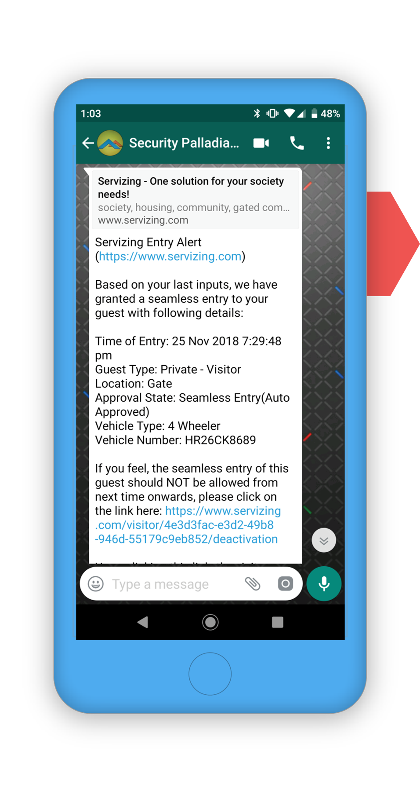
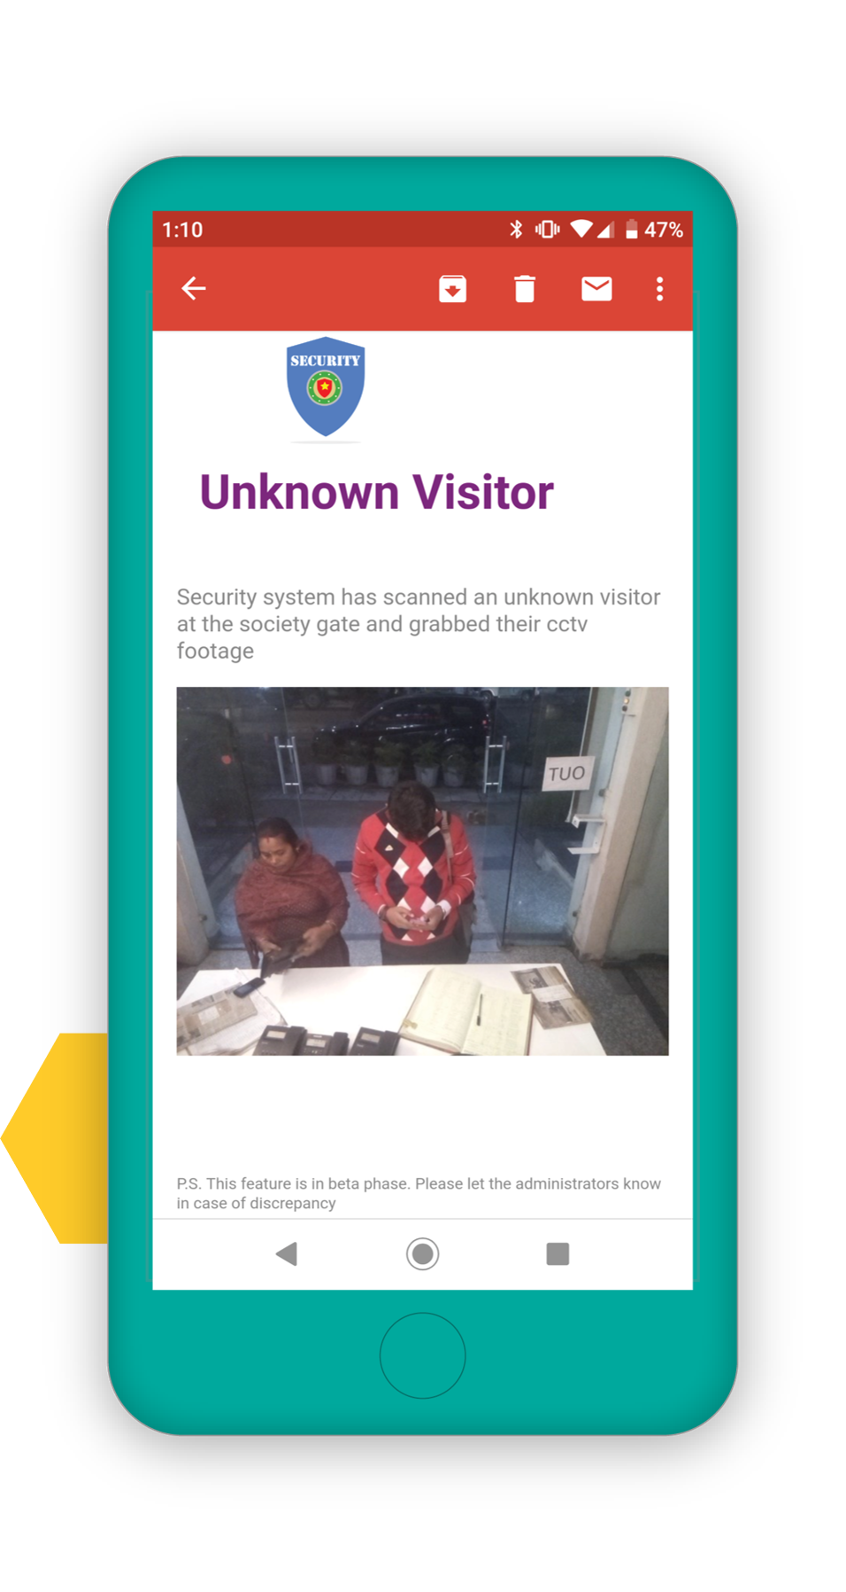
WhatsApp
notifications for
Visitor Alerts
Unknown VisitorAlerts with CCTV capturing photos

Slide 7
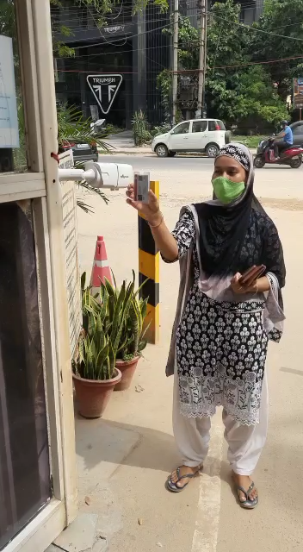
Live View

Slide 8
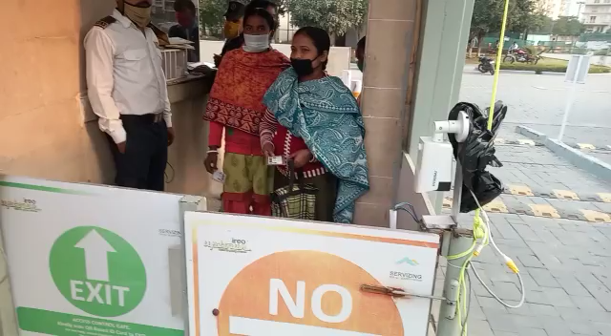
Live View

Slide 9
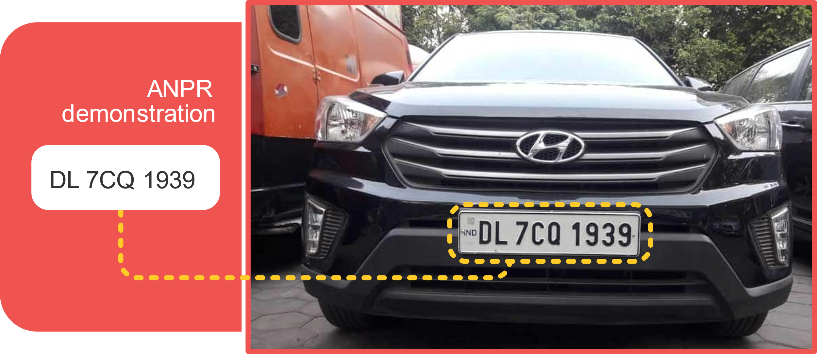

Slide 10

CCTV
BASED WEB
INTERCOM

Slide 11
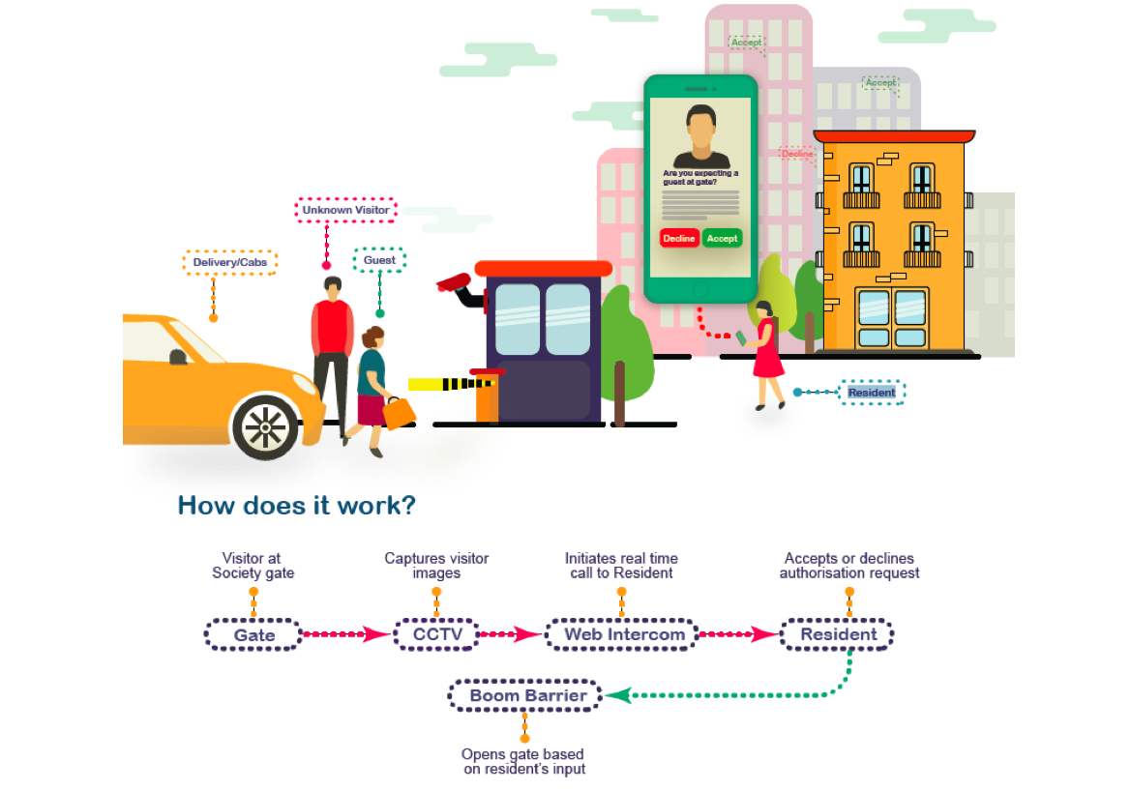
CCTV BASED WEB INTERCOM
HOW DOES IT WORK?

Slide 12
VISITOR MANAGEMENT
ENSURE EXIT
01.
02.
Human less exit
system using existing
barriers
2 year audit trail of
all kinds of entry & exit
03.
04.
Access denial report &
analytics every night
to estate office &
security teams
Automated overstay alerts
for cabs, vendors like
pizza delivery

Slide 13
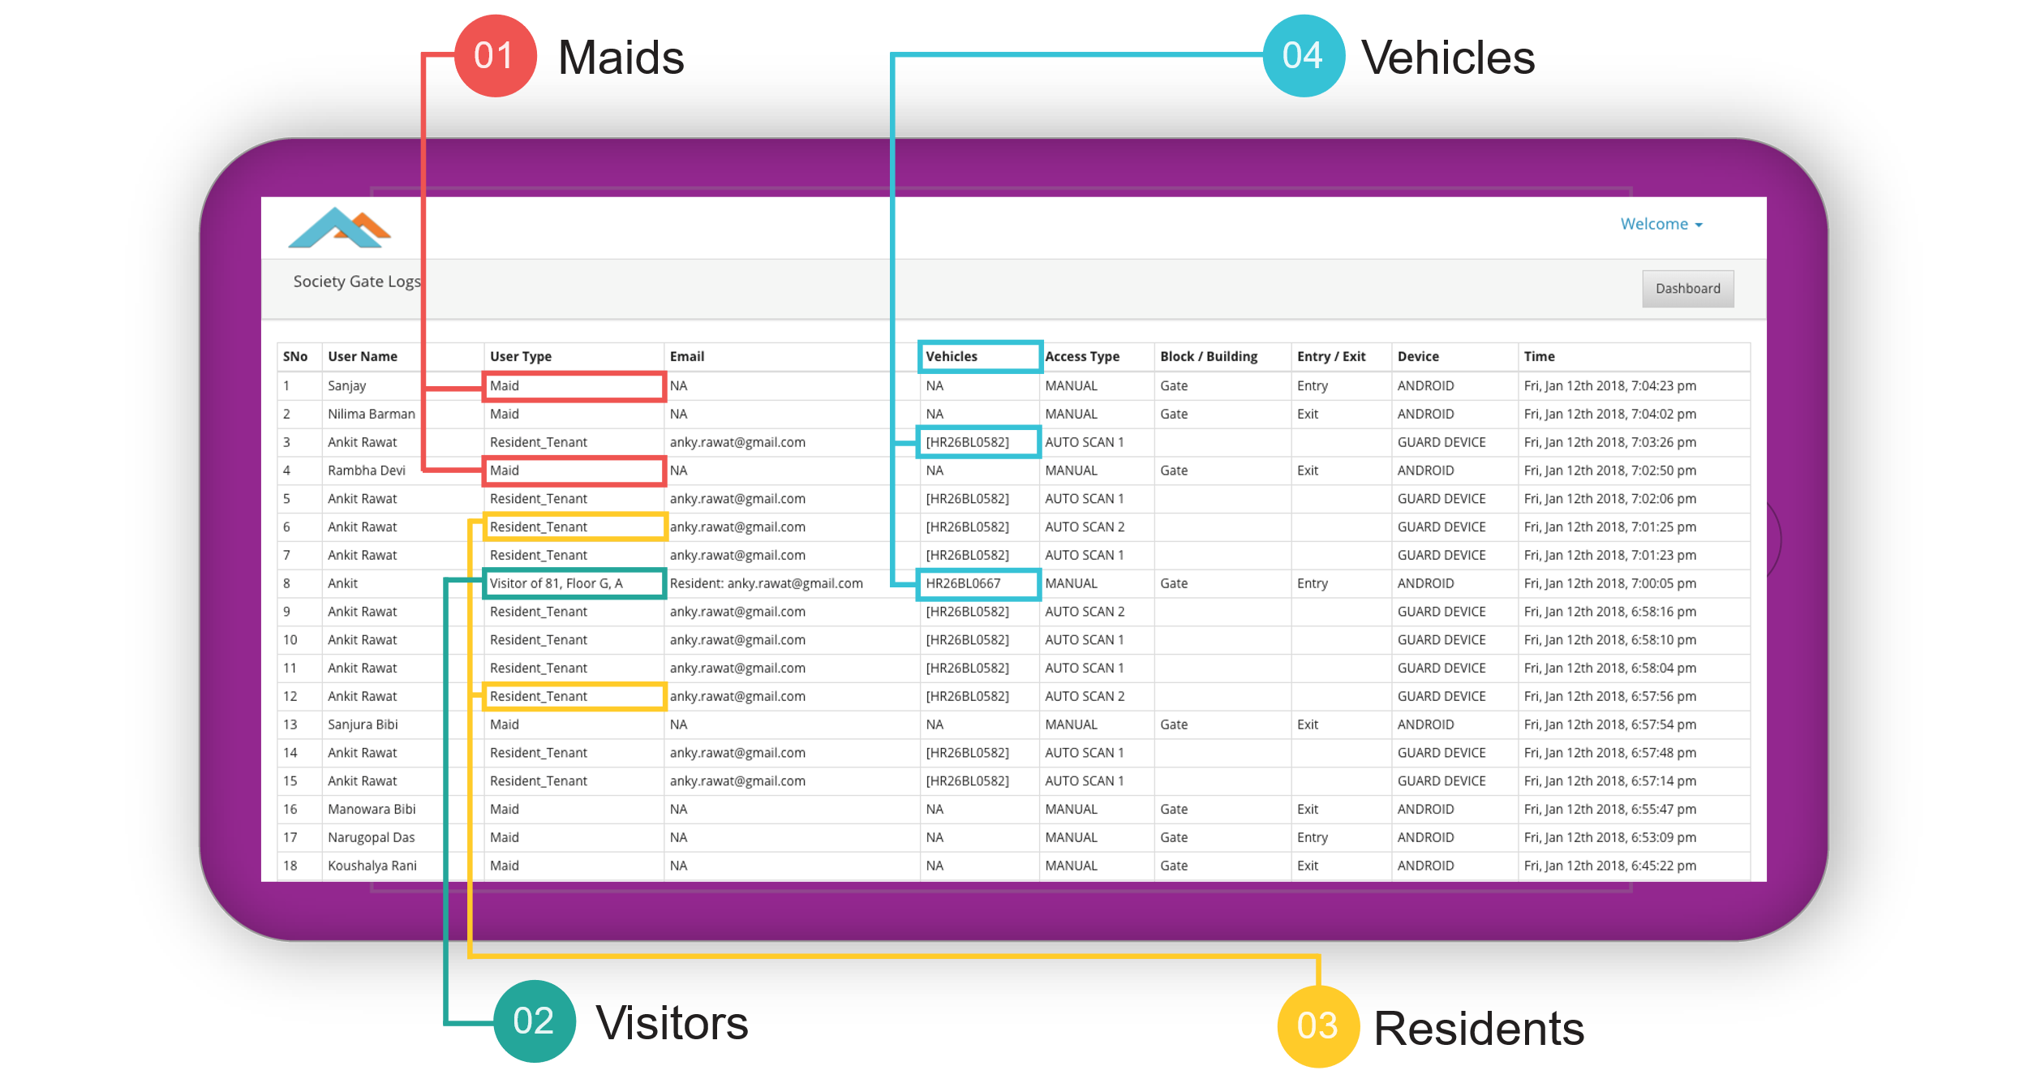
Entry/Exit Audit Trail

Slide 14


BILLING
MADE EASY

Slide 15
TRANSACTION MANAGEMENT
BILLING MAINTENANCE AND ACCOUNTING
01.
02.
Zero Transaction
Charges on Credit,
Debit Card, NetBanking
& UPI.
Tally Automation -
Integration without any
manual intervention
03.
04.
Payment directly gets
into RWAs account
Deep integration with
your bank and seamless
reconciliation

Slide 16
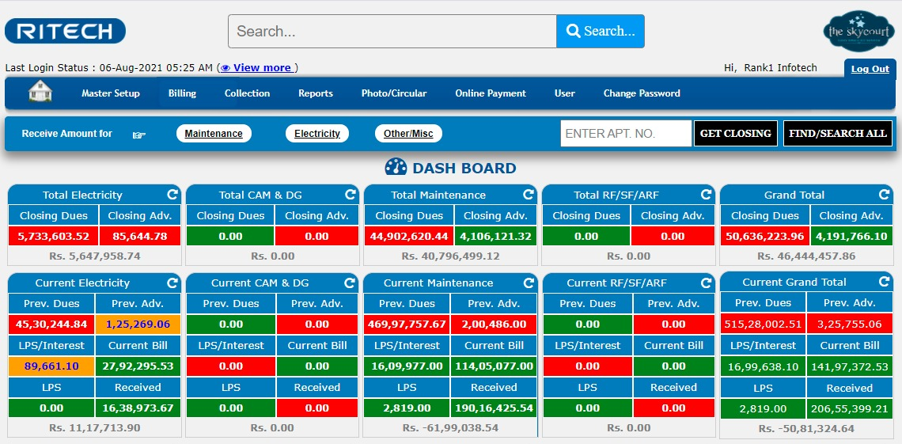
BILLING MANAGEMENT VIEW

Slide 17
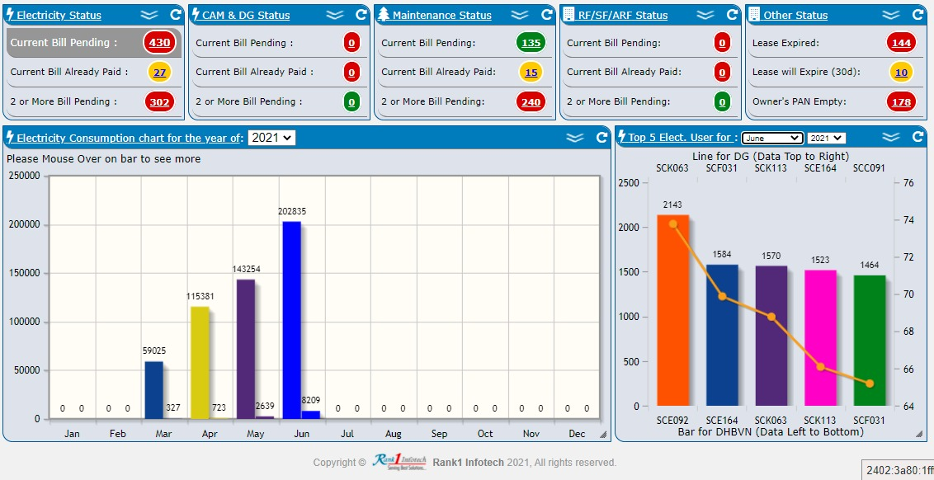
DRILL DOWN VIEW

Slide 18
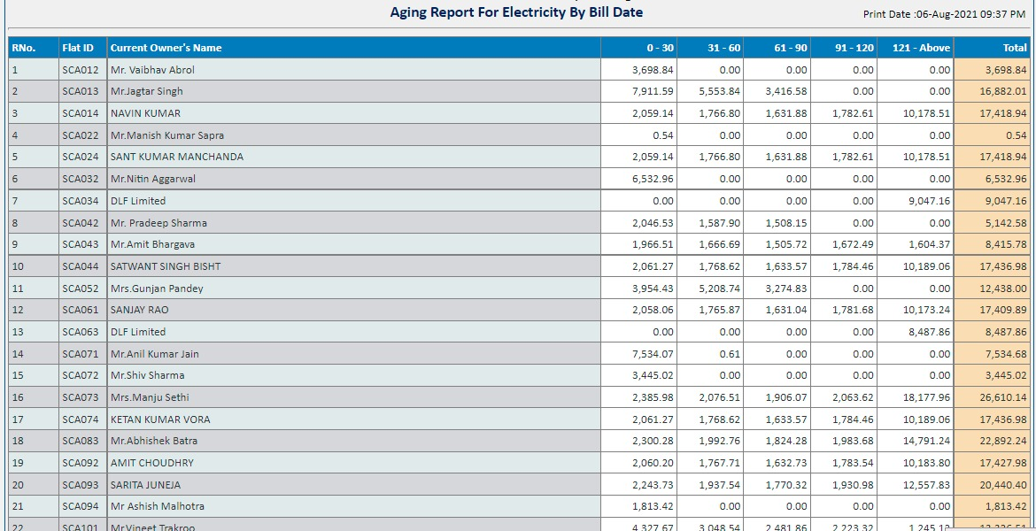
AGING VIEW

Slide 19
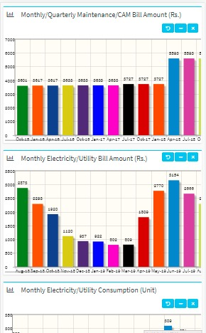
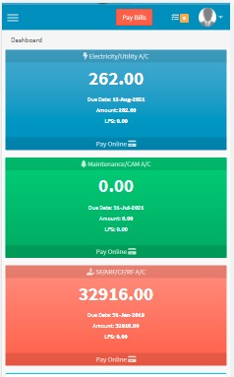
BILLING MANAGEMENT – MOBILE VIEW
Graphical View
of Charges
Neat & Intuitive
Billing Interface

Slide 20
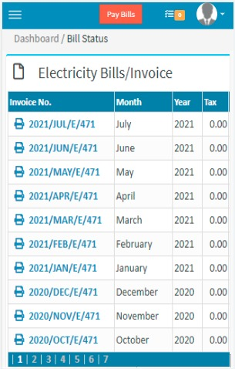
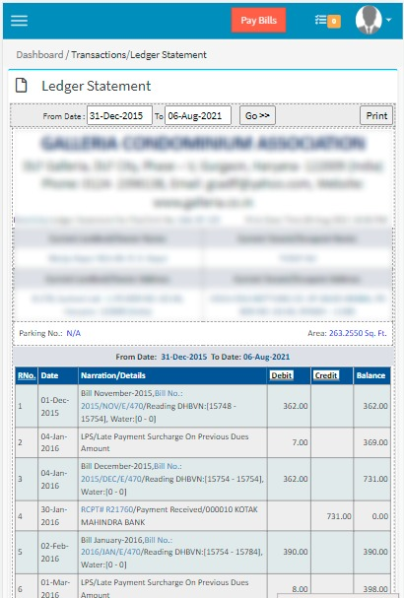
BILLING DASHBOARD – RESIDENT VIEW
Ledger Statement
Printable Invoice

Slide 21
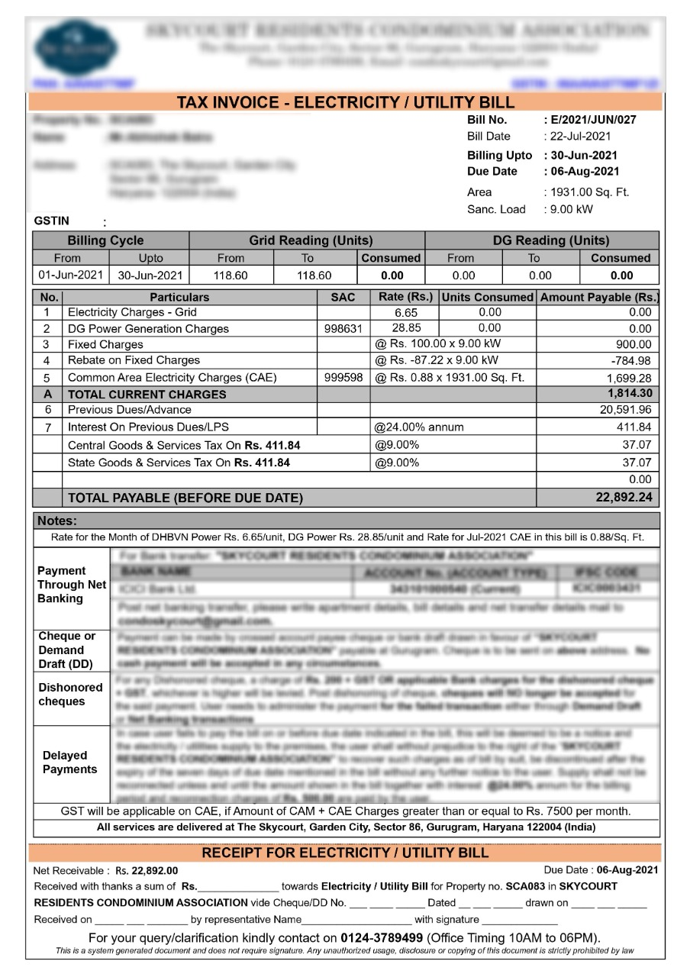
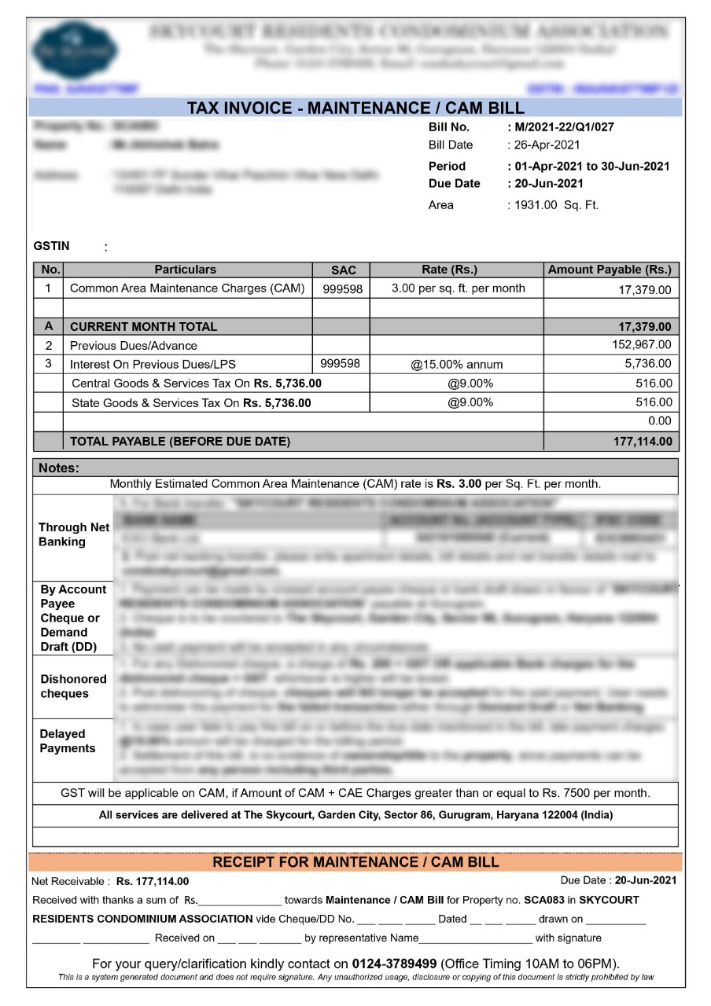
CUSTOMIZABLE INVOICE FORMAT

Slide 22
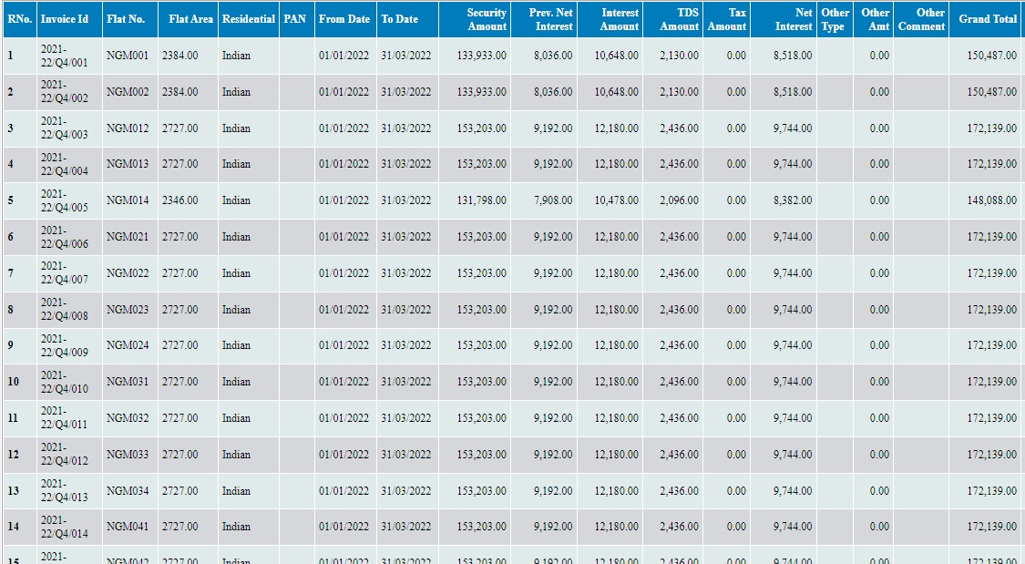
IBMS CALCULATION SHEET

Slide 23
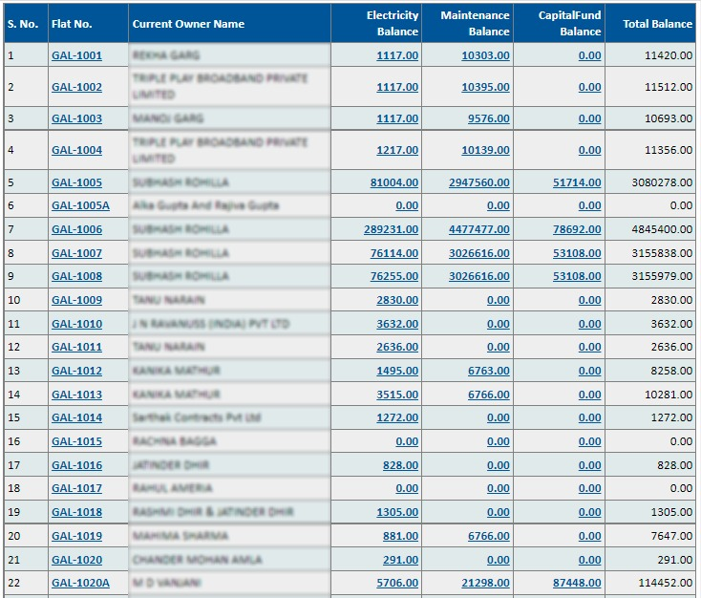
CONSOLIDATION SUMMARY

Slide 24
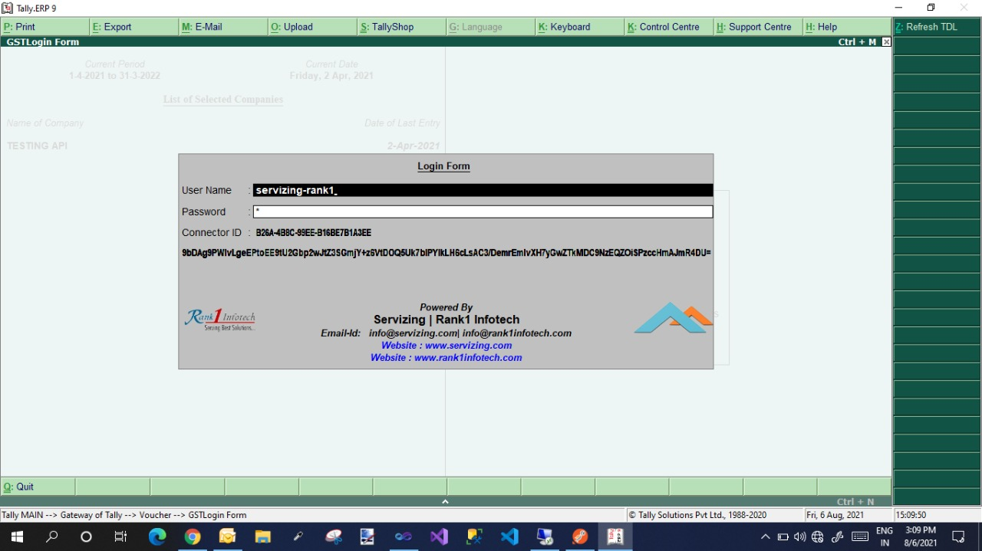
TALLY AUTOMATION

Slide 25

HELPERS
AND STAFF

Slide 26
VISITOR MANAGEMENT
HELPERS AND STAFF
01.
02.
03.
04.
Automated entry &
exit for all helpers
Biometric (Face,
Fingerprint or Retina
Scan) & QR code
Tripod Turnstile/Flap
barrier integration
Cost effective tower
based scanning
using QR code
05.
06.
07
08.
Association of helpers
with residents using
QR code
Search maid and
helpers using AI
engine
Block 24*7
maids and
helper
Luggage screening
system

Slide 27
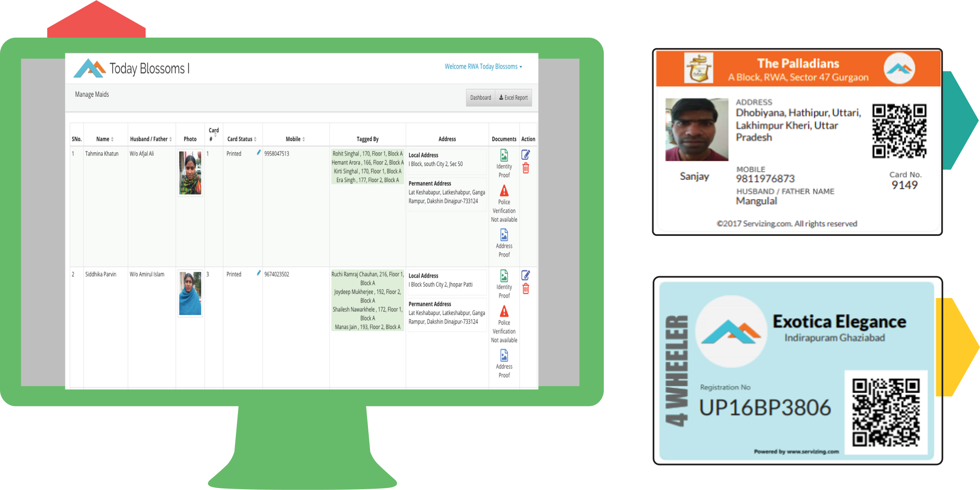
Maids Management Dashboard
Maids ID Card
Vehicle Pass
Image showing runtime association & digitization

Slide 28
VISITOR MANAGEMENT
VEHICLE TRACKING AND PARKING WORKFLOW
01.
02.
Guest can be tracked easily
and workflow gets created
upon incorrect parking
Photo Proof of incorrect parking
can be resolved through the
RWA dashboard
03.
04.
Analytical report on
repeated failures of
parking correctly
False reporting or complaints
can also be tracked down

Slide 29
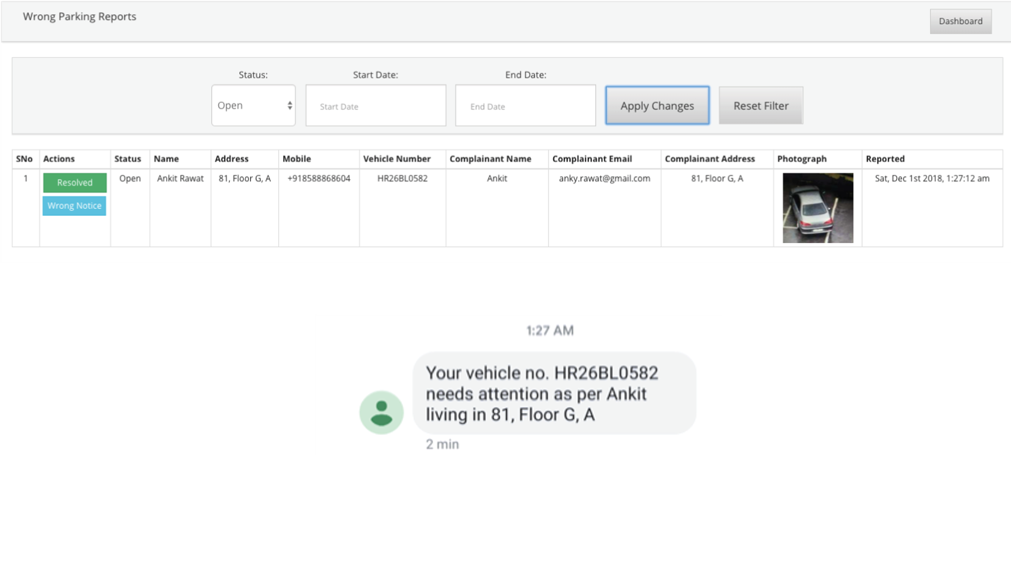
Picture showing incorrect parking workflow

Slide 30
VISITOR MANAGEMENT
LUGGAGE SCREENING
01.
02.
Any asset taken out of the campus
by helper or staff will be scanned
and verified through staff QR
No phone authentication or
paper slip authentication
is required

Slide 31
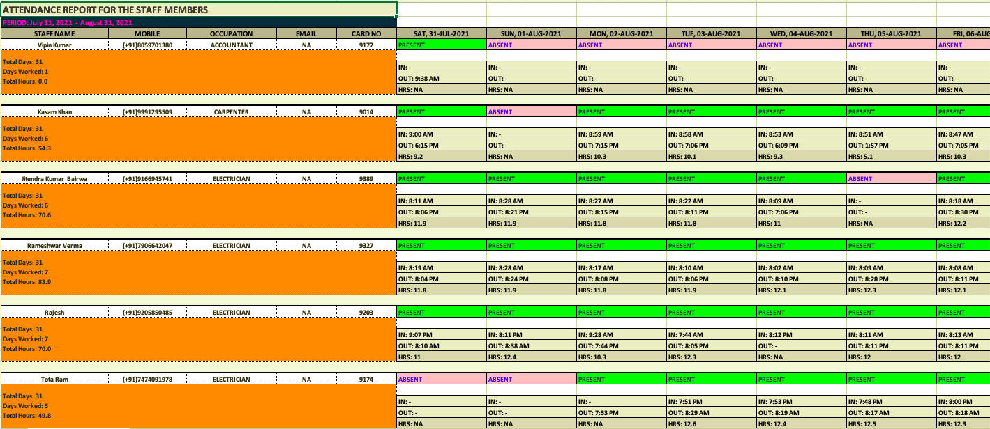
ATTENDANCE RWA STAFF
ACCURATE AND CLEAR

Slide 32
PREPAID METER
SECURE METERS
01.
02.
Bills can be generated
with detailed break up
of all the charges
Support for integration
with Secure Meters,
Xenius & Ensol
03.
04.
Bills of last two years
can be viewed/downloaded
by Residents
Support for payment
Integration via Paytm,
Citrus, instamojo etc

Slide 33
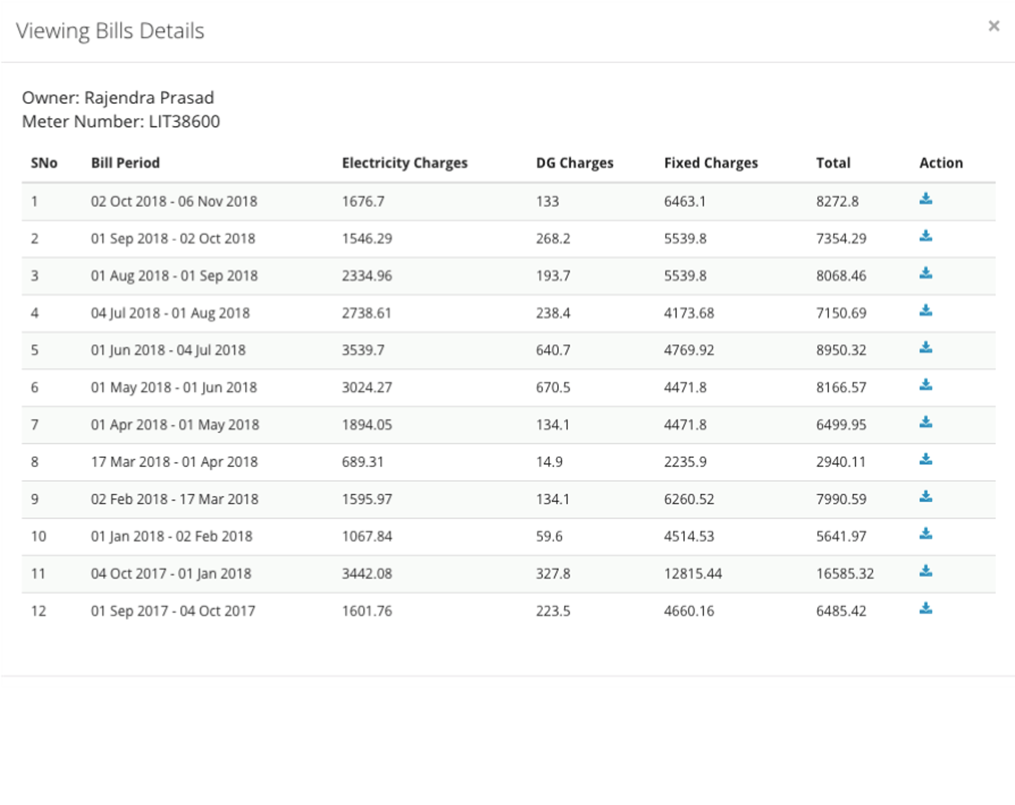
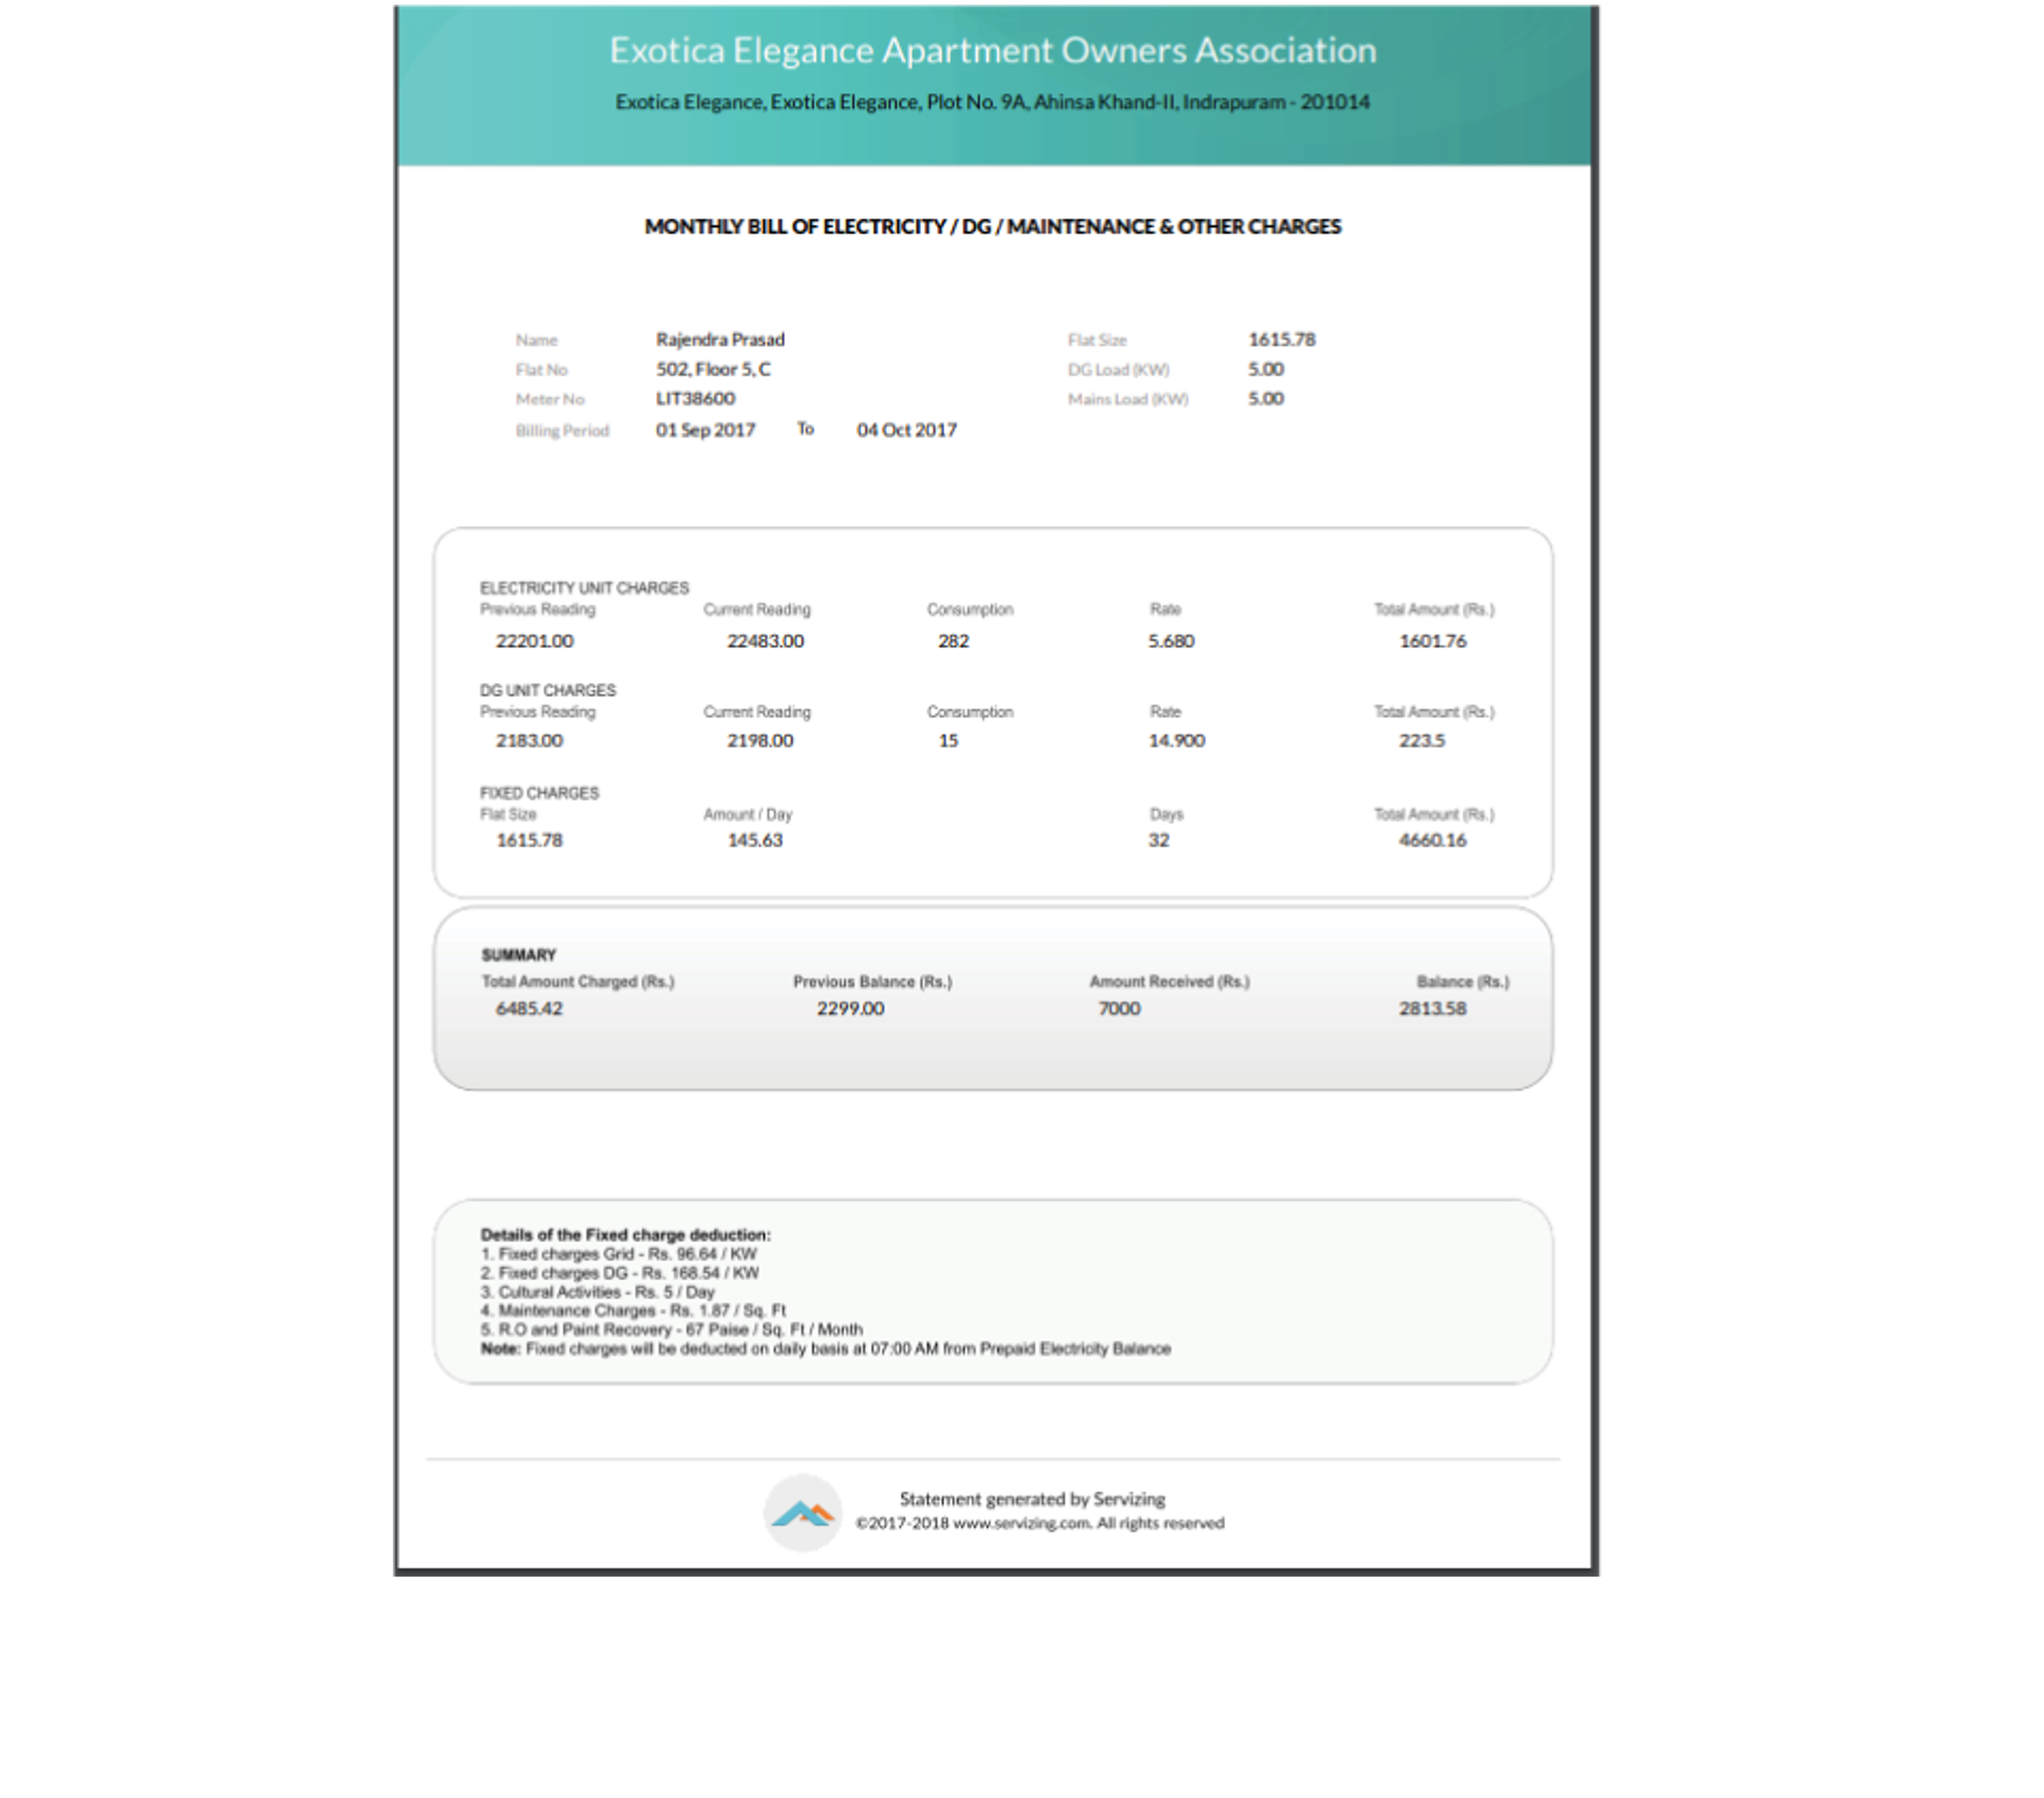
Picture showing archived bill
Picture showing sample bill copy

Slide 34

HANDYMAN
SERVICES

Slide 35
HANDYMAN SERVICES
ORDER MANAGEMENT
01.
02.
03.
Order request of based
services on FCFS basis
& ensure closure
SLA track of all the
services inclusive of
Order Timeline
Realtime queue status
of service displayed
04.
05.
06.
Feedback & cumulative
rating for all service
provider for transparent
R&R policy
Realtime status of
number of service
provider working on
the queue
Analytics on all SLA
breaches

Slide 36
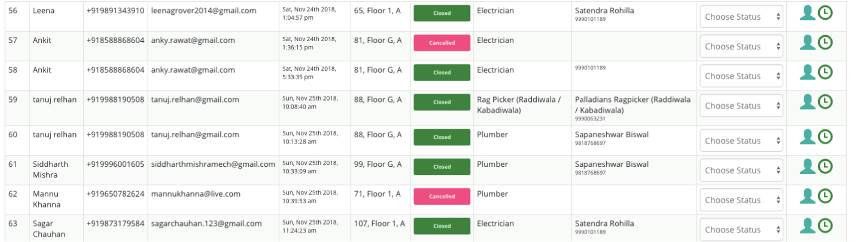
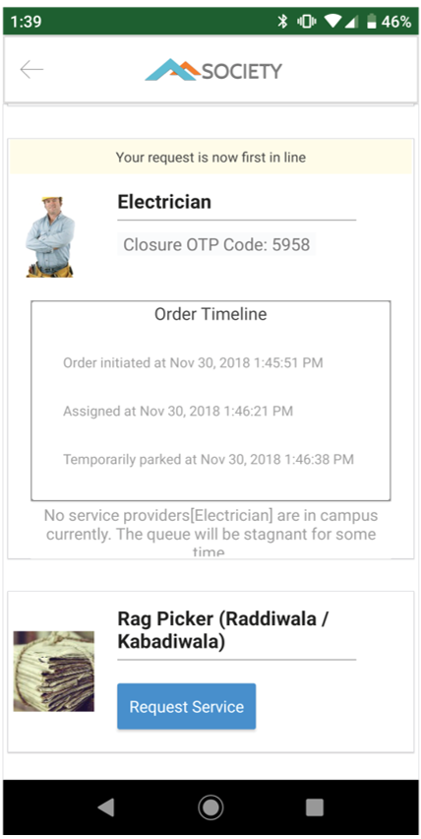

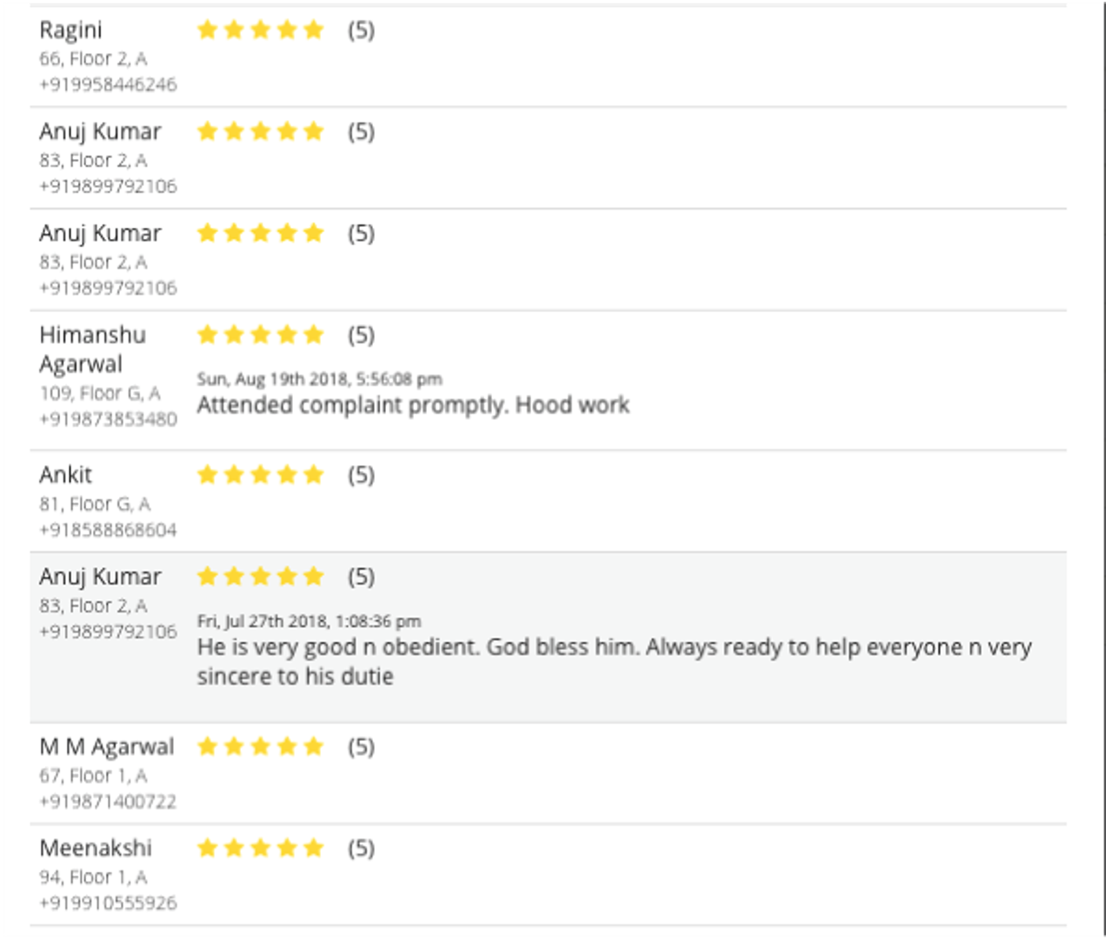


Picture showing order tracking
Picture showing feedback
and comments
Order booking and timeline

Slide 37




OTHER FEATURES
Voting & Polls
Let your opinion
be known on all
Society polls
Information Center
RWA
announcements
and communications
Activities
Join an activity
club or a group
Yellow Pages
Now find all
the recommended
services & contacts
at one place

Slide 38
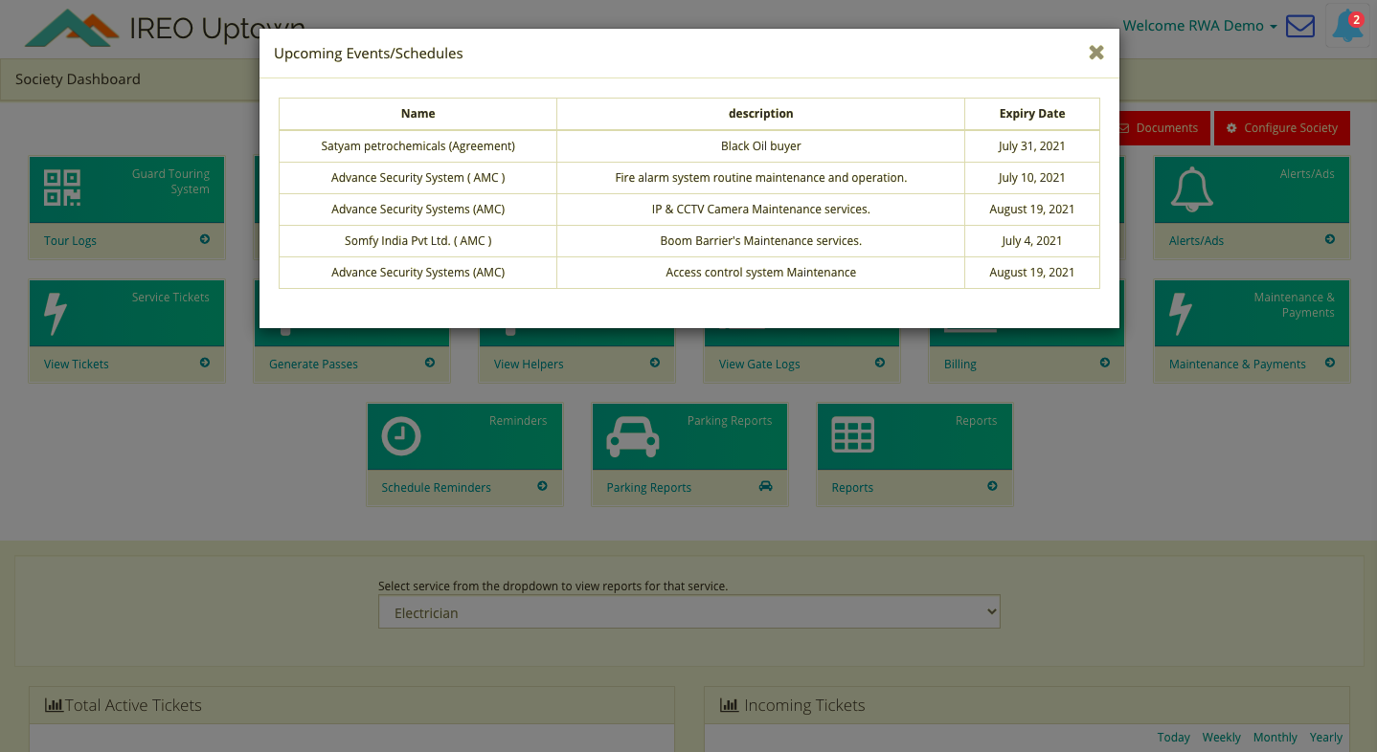
AMC ALERTS

Slide 39


LIVE POWER ALERTS
Power Outrage
Grid Power Normal

Slide 40






AIR QUALITY INDEX
Good
Moderate
Unhealthy for
sensitive groups
Unhealthy
Very Unhealthy
Hazardous

Slide 41

BOOM BARRIER
01.
02.
Automation based on Fast Tag
Just Vehicle/Chassis Number is
Needed to Activate/Deactivate
03.
04.
Realtime Notifications
Integration with New/Old Barrier
System
05.
04.
Central Logging System with 1 year audit trail
Integration with New/Old Barrier
System

Slide 42

THANK YOU
For any query write us to info@servizing.com
Visit www.servizing.com for more details

